Slide 1
Book Breeze
~Ayushi Singh & Vipul Mhatre
Link to preview:
https://www.figma.com/file/FWTBmc4BaUTru0t3pIsghR/UX_evolve--Aesthetic_Visuals?type=design&node-id=0%3A1&mode=design&t=xF2zjewoZhlzNtDV-1

Slide 2
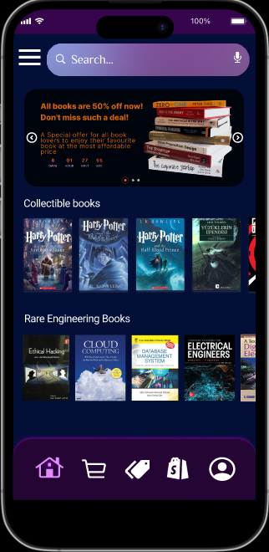
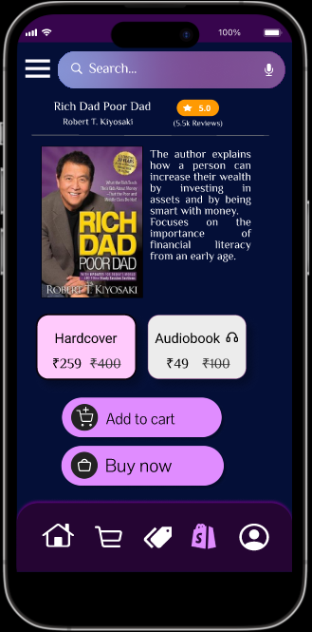
Project overview
The product:
Book Breeze is a specialized online bookstore that caters to collectors, bibliophiles, and enthusiasts seeking rare and collectible books. Our platform is dedicated to curating and offering a carefully selected collection of unique literary works, manuscripts, first editions, and historically significant books. With a commitment to providing comprehensive book descriptions, historical context, and both buying and auctioning options, Book Breeze is the ultimate destination for those passionate about literary rarities.
Project duration:
2-10-2023 12:00 am to 6:00 am

Slide 3
Project overview
The problem:
Limited Access: Accessing rare and collectible books can be challenging for collectors, as these items are often scattered across various physical and online marketplaces. Finding specific books or trustworthy sellers can be a time-consuming and frustrating process.
Lack of Information: Many collectors and enthusiasts struggle to find detailed information about the rare books they are interested in. This lack of information includes details about the book's condition, historical context, and authenticity.
.
The goal:
Centralized Access: To provide a centralized and easily accessible platform for collectors and enthusiasts to explore, discover, and acquire rare and collectible books from various genres and historical periods.
Detailed Information: To offer detailed and accurate information about each book, including its condition, provenance, historical significance, and unique features. This information helps users make informed decisions about their purchases.

Slide 4
Project overview
Our role:
Visual Design: Create the visual elements of the app, including layout, typography, color schemes, and iconography.
Graphic Design: Design buttons, icons, images, and other graphical assets that align with the app's branding and theme.
Consistency: Ensure a consistent and visually appealing design throughout the app, maintaining brand guidelines.
Responsiveness: Design UI elements to be responsive to different screen sizes and orientations.
Prototyping: Create static or interactive prototypes that showcase the visual design and layout.
.
Responsibilities:
Conducting interviews, paper and digital wireframing, low and high-fidelity prototyping, conducting usability studies, accounting for accessibility, and iterating on designs.

Slide 5
Understanding
the user
User research
Personas
Problem statements
User journey maps

Slide 6
User research: summary
We conducted interviews and created empathy maps to understand the users we’re designing for and their needs. A primary user group identified through research was working adults who don’t have time to visit book stores themselves.
This user group confirmed initial assumptions about book breezes’ customers, but research also revealed that time was not the only factor limiting users to visit book stores. Other user problems included obligations, interests, or challenges that make it difficult to get search for good offline bookstores or go looking for rare books.

Slide 7
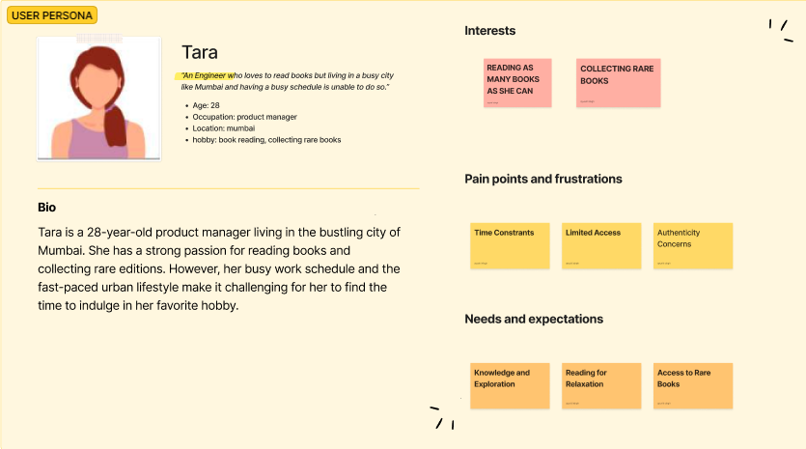
Persona: TARA
Problem statement:
Tara represents a valuable user persona for the Book Breeze app, highlighting the app's ability to cater to the needs of book enthusiasts and collectors, especially those with busy urban lifestyles who seek convenient access to rare and collectible books.

Slide 8
Starting
the design
Paper wireframes
Low-fidelity prototype

Slide 9
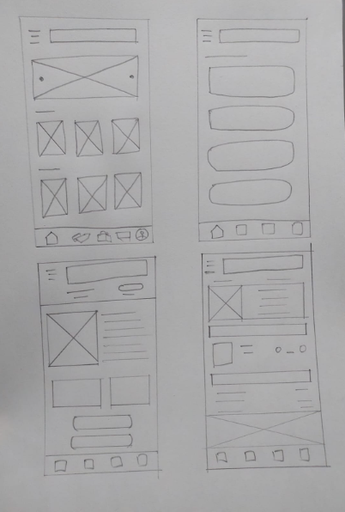
Paper wireframes
Taking the time to draft iterations of each screen of the app on paper ensured that the elements that made it to digital wireframes would be well-suited to address user pain points. For the home screen, I prioritized a quick and easy ordering process to help users save time.

Slide 10
Refining
the design
Mockups
High-fidelity prototype
Accessibility

Slide 11
Before usability studies
After usability studies
Mockups

Slide 12
Before usability study 2
After usability study 2
Mockups

Slide 13
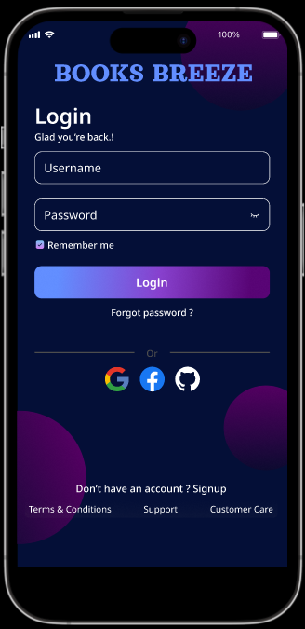
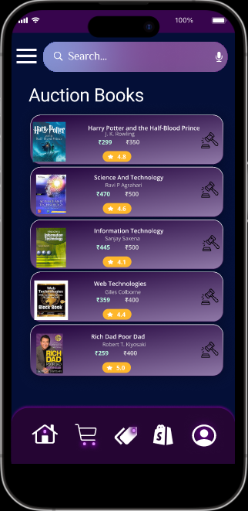
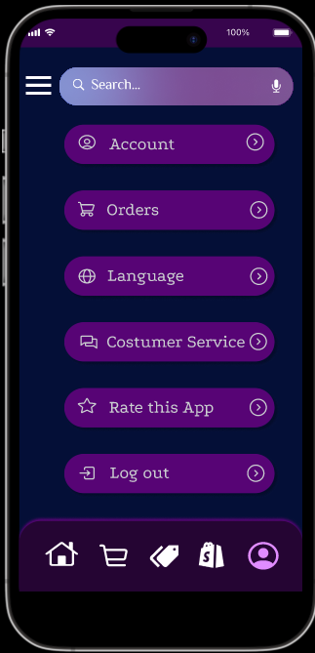
Key mockups

Slide 14
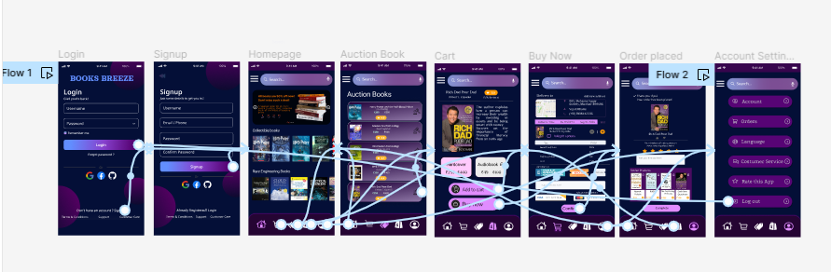
High-fidelity prototype
The final high-fidelity prototype presented cleaner user flows for booking a book and checkout. It also met user needs for a pickup or delivery option as well as more customization.

Slide 15
Thank you!

